Slide 1



Isotope Production Activities Update
10 December 2018
Notes:
Emerging trends for next-generation (targeted & personalized) nuclear medicine:
Targeted alpha therapy (5-10 MeV)
40-80 μm range → single cell
Targeted Auger therapy (20 eV – 1 keV)
1 nm – 2 μm → cellular nucleus
Theranostic medicine
Simultaneous imaging and therapy

Slide 2
Stacked-target Charged Particle Excitation Functions
___________________________
^{Low(er) Energy – LBNL}
Notes:
Cyclotron
Many hospitals have small K~15 medical cyclotrons for PET tracer production
Leverage existing infrastructure
Explore higher energies for regional research cyclotrons, basic science
Linac
Commonly used for high-energy production (LANL – IPF)
Useful for anchoring to complementary low-energy measurements

Slide 3
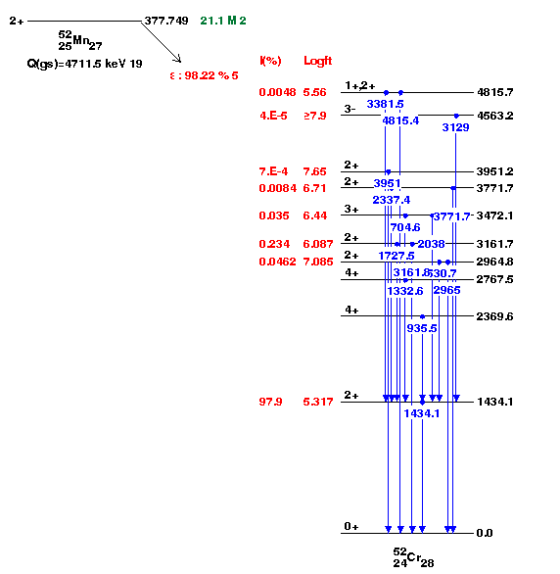
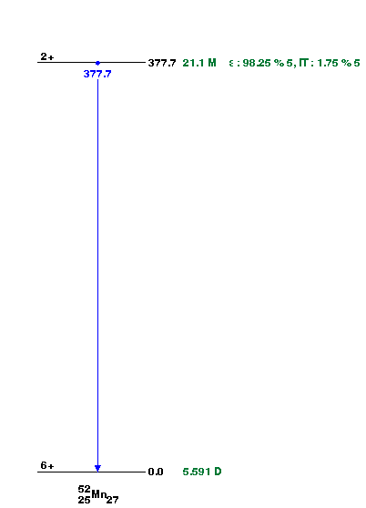
Emerging medical radionuclides
⁵¹Mn (t_{1/2} = 46 min, 97% β⁺) – short-lived PET tracer for metabolic studies
Best option for clinical imaging, needs in-house production
^{52g}Mn (t_{1/2} = 5.6 d, 29% β⁺) – long-lived PET tracer for neuron tracking, immune studies
Long half-life, unfavorable gammas make this best-suited to pre-clinical imaging
Easy distribution
^{52m}Mn – short-lived PET tracer for metabolic studies
Difficult to produce, must be done in-house
Interesting lens to study behavior of excited states in p_{3/2} / f_{7/2} nuclei
 | ^{52g}Mn | ^{52m}Mn | ⁵¹Mn
Half Life | 5.6 d | 21 m | 46 m
β⁺ Branch | 29% | 97% | 97%
β⁺ Avg. Energy | 242 keV | 1172 keV | 973 keV
Gammas | 744, 935, 1434, … | 1434 | 749

Slide 4
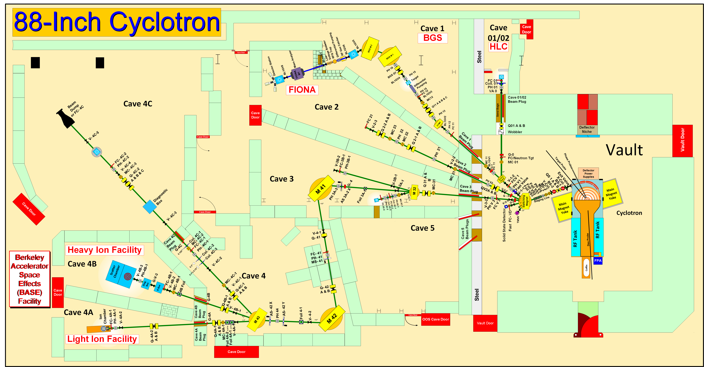
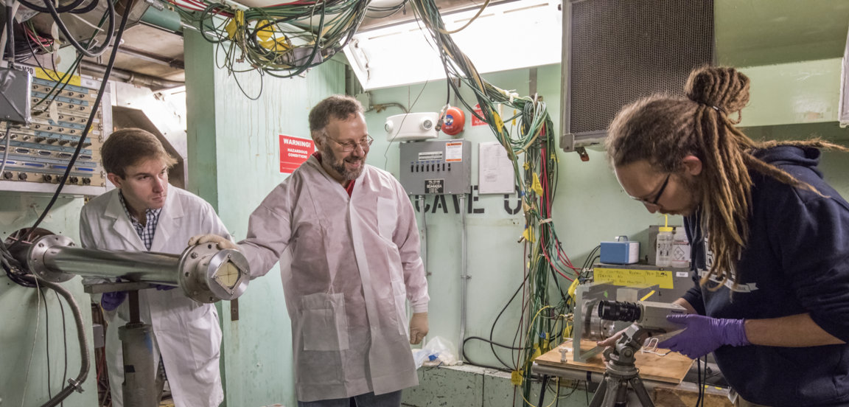
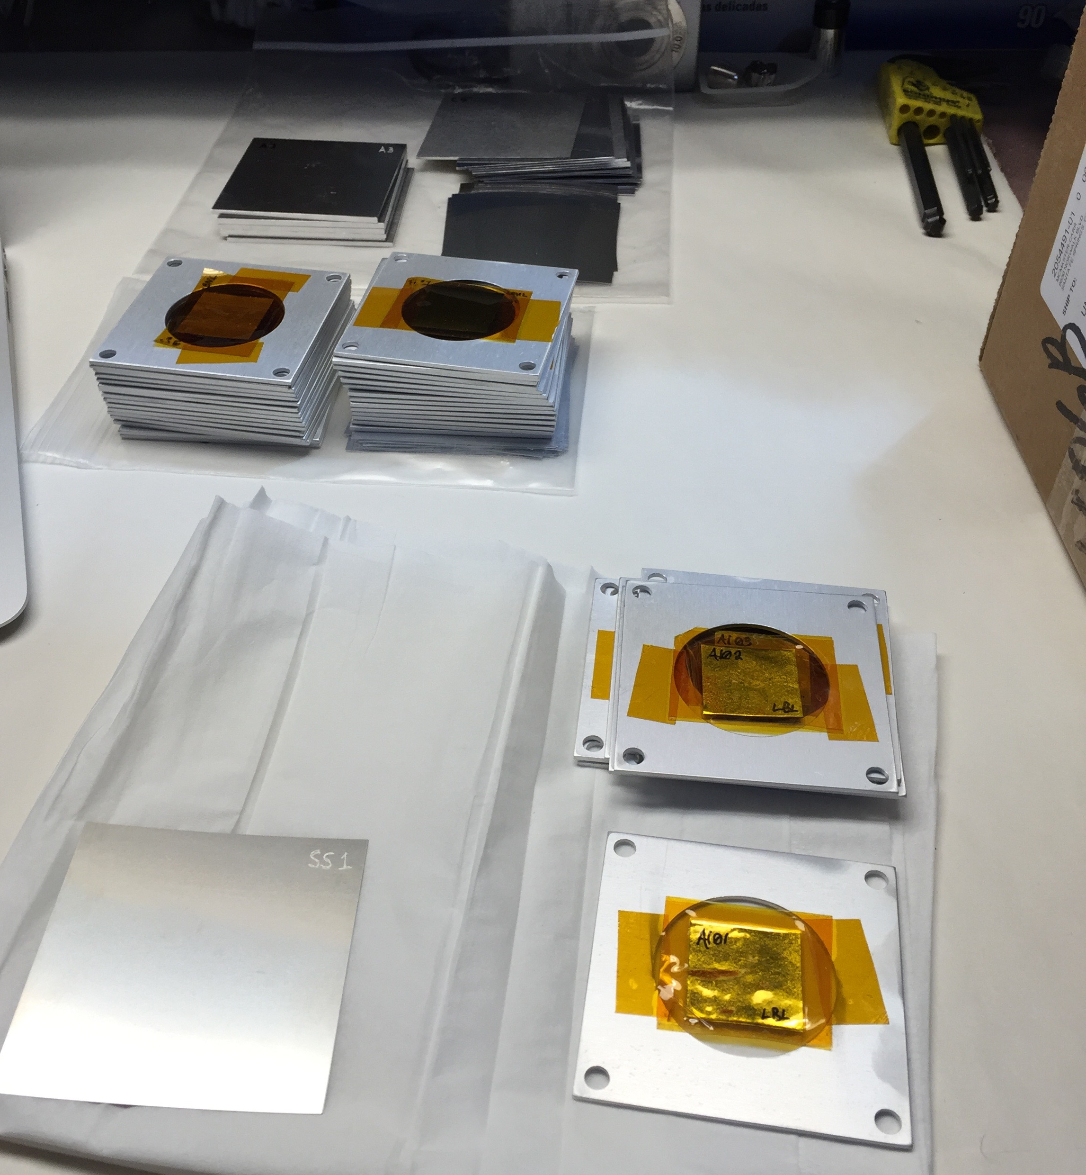
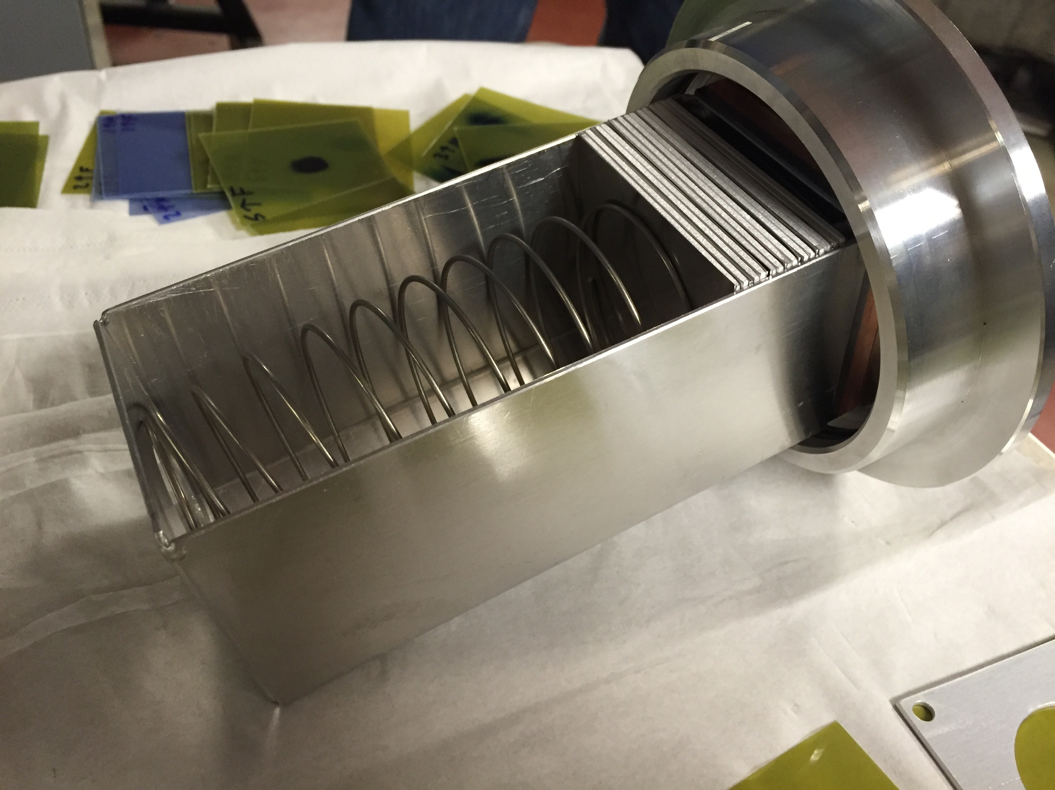
Stacked-target Charged Particle Excitation Functions
A. Springer
L. Bernstein
K-140
2016: Launched a complementary nuclear data measurement campaign at the LBNL 88-Inch cyclotron to address gaps in reaction data at E<60 MeV/A
Notes:
We propose to measure these reactions to resolve ambiguity in the predictions and establish optimal irradiation parameters.
Cyclotron freq w = Q B / m
T = (m/2) w^2 r^2
T/A = (B r / 2 m)^2 (Q/A)^2 = K (Q/A)^2

Slide 5
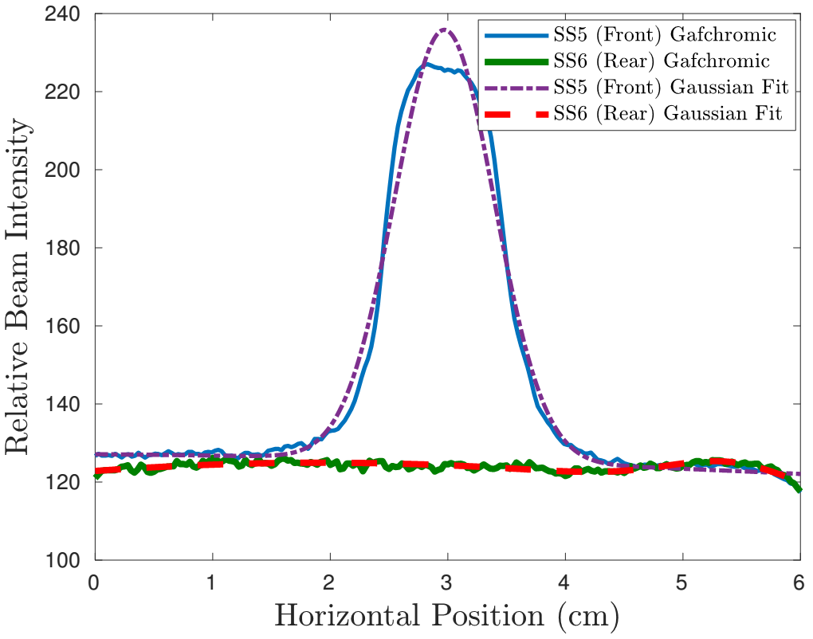
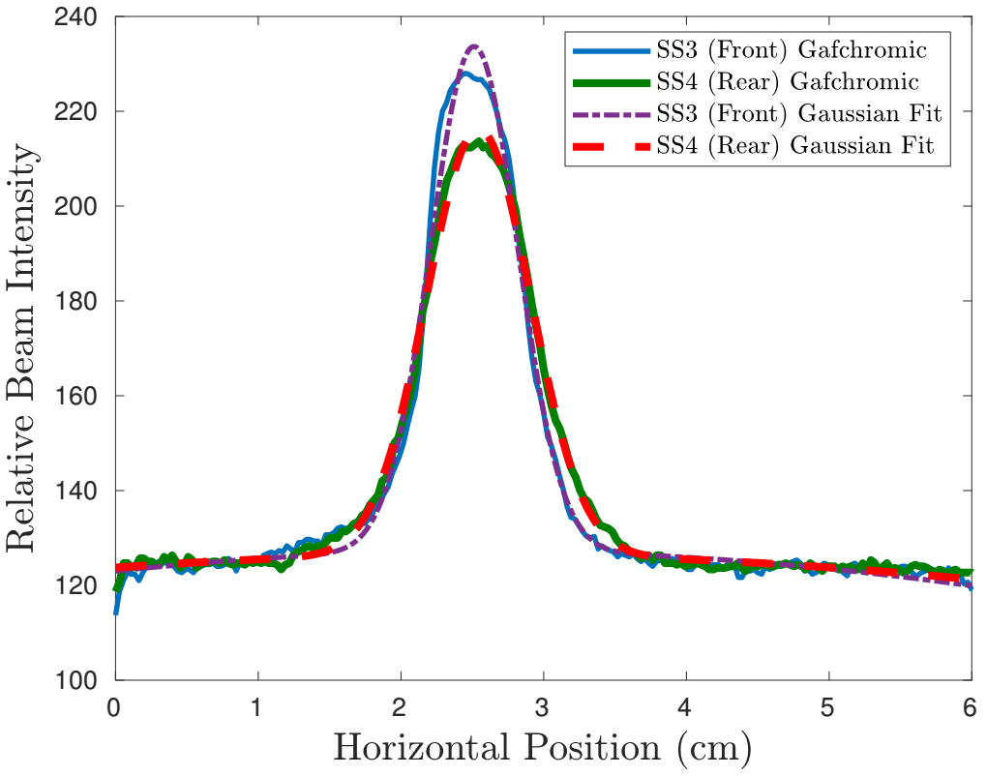
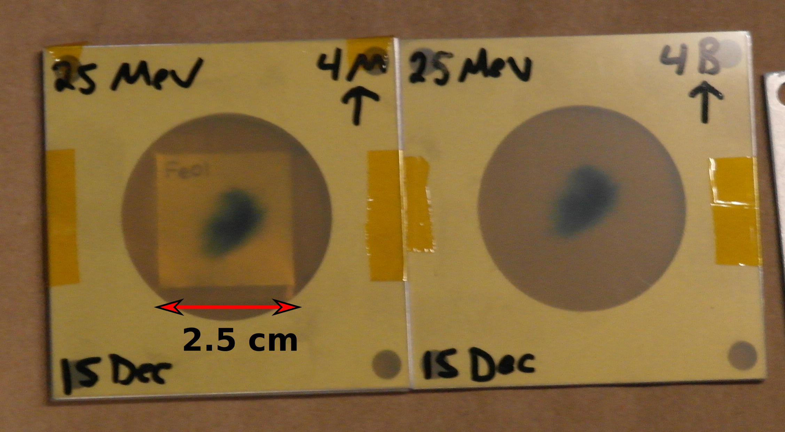
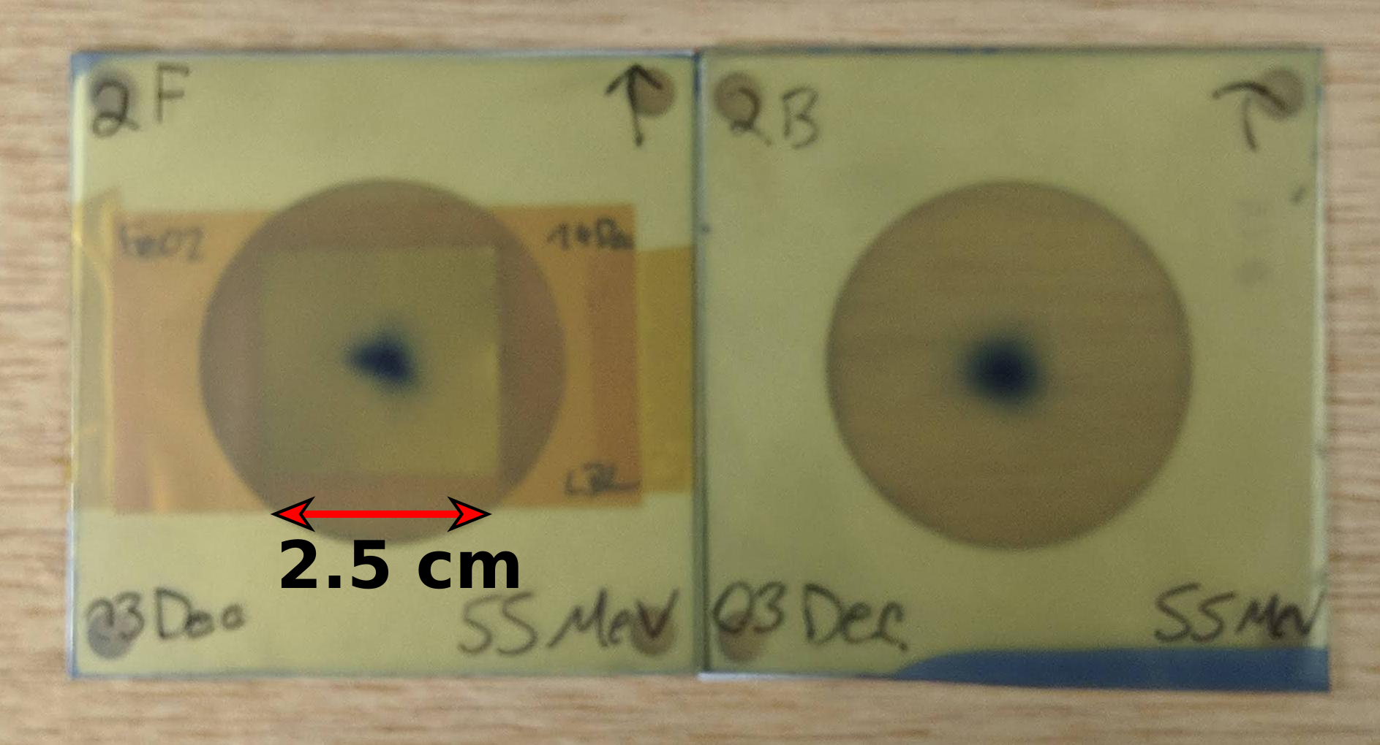
^{nat}Fe(p,x)^{51,52}Mn – Novel PET imaging
Two overlapping stacks: E_{p}= 55→15 MeV, 25→0 MeV (120 nA@10 min, 100 nA@20 min)
Notes:
Mention issues with Levkovski!
Low peak is 54Fe(p,x), high peak is 56Fe(p,x)

Slide 6
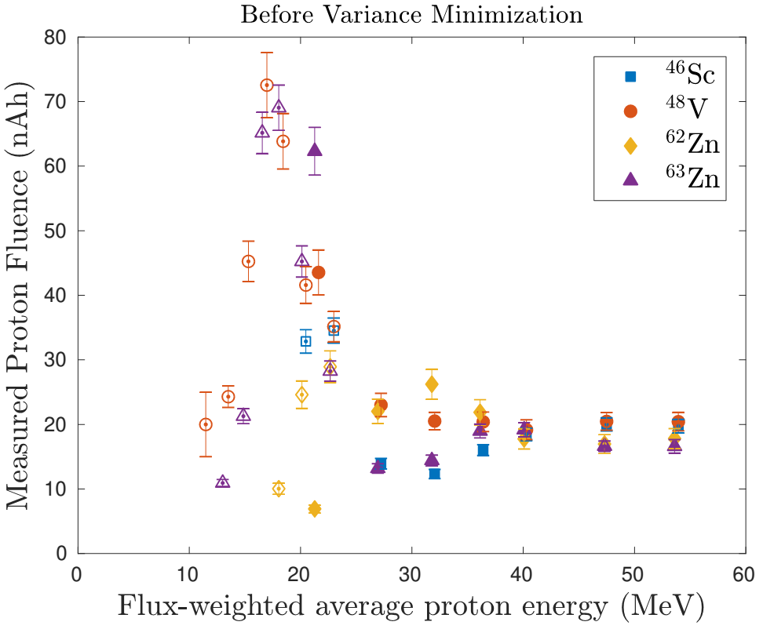
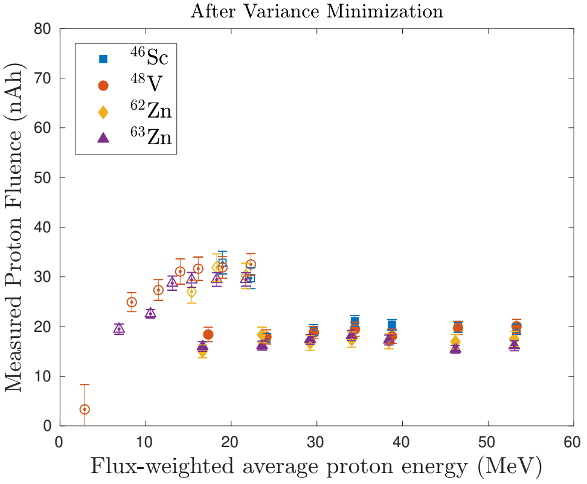
^{nat}Fe(p,x)^{51,52}Mn – Novel PET imaging
Variance minimization:
55 MeV: +5.25% Al density
25 MeV: +6.69% silicone density
Notes:
Mention issues with Levkovski!
Low peak is 54Fe(p,x), high peak is 56Fe(p,x)

Slide 7
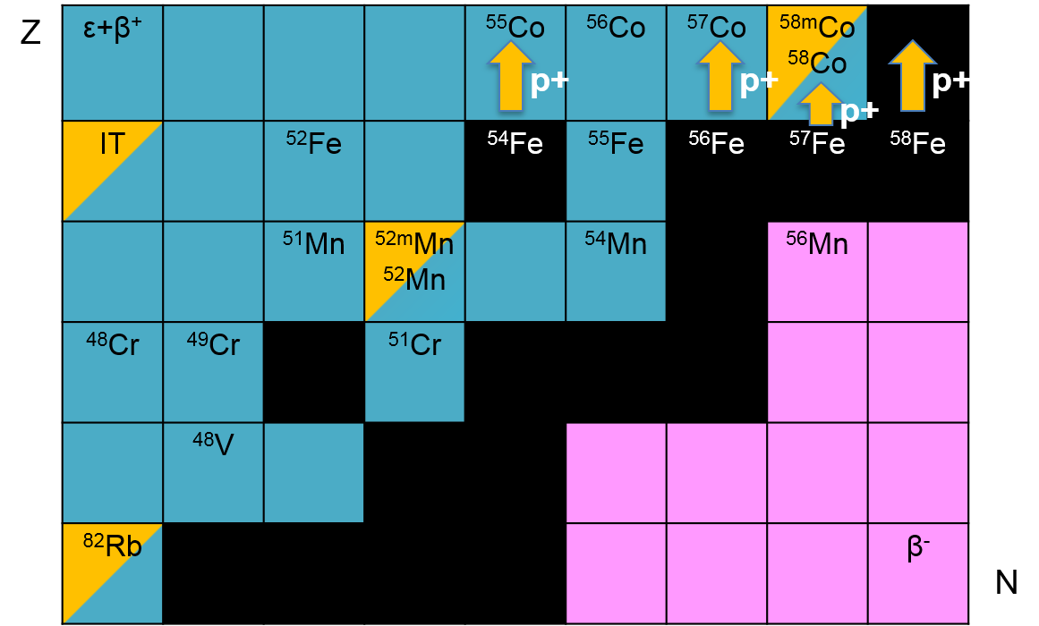
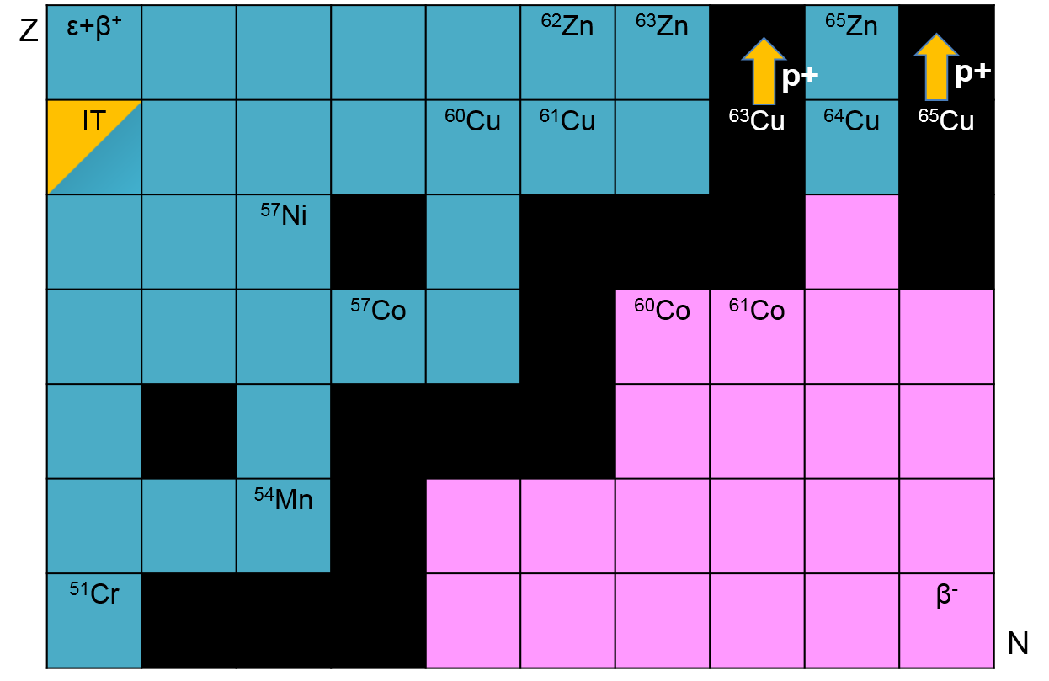
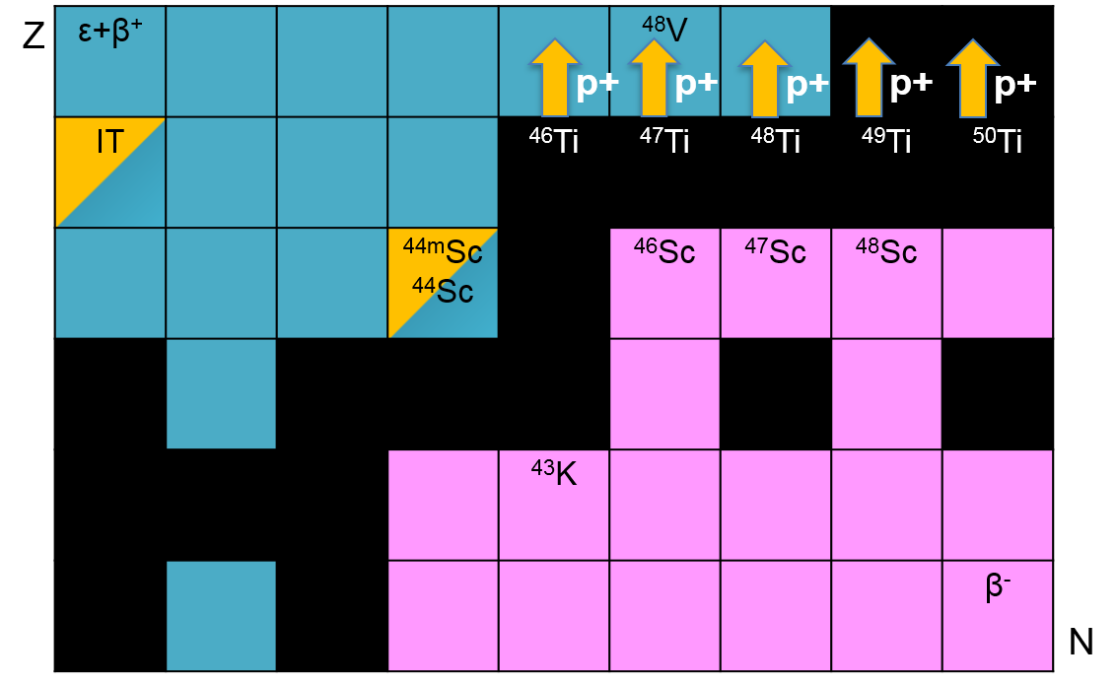
^{nat}Fe(p,x)^{51,52}Mn – Novel PET imaging
Measurements of 34 cross-sections for ^{nat}Fe(p,x), ^{nat}Cu(p,x), and ^{nat}Cu(p,x)
Notes:
Mention issues with Levkovski!
Low peak is 54Fe(p,x), high peak is 56Fe(p,x)

Slide 8
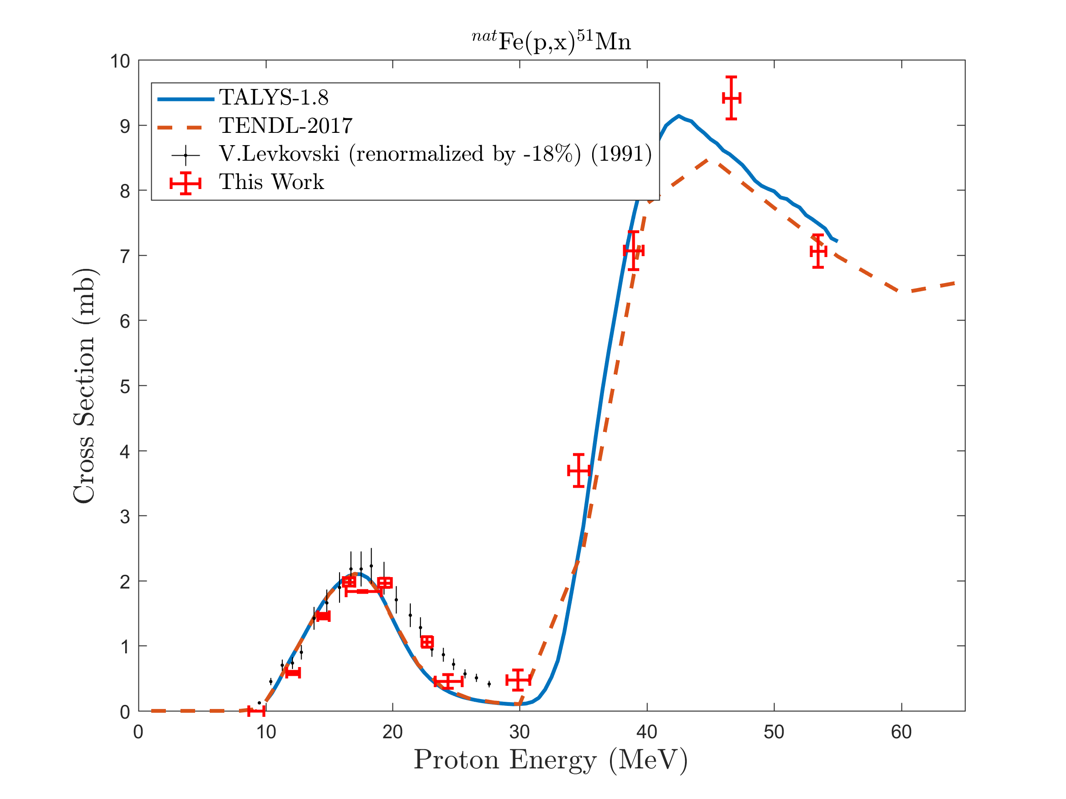
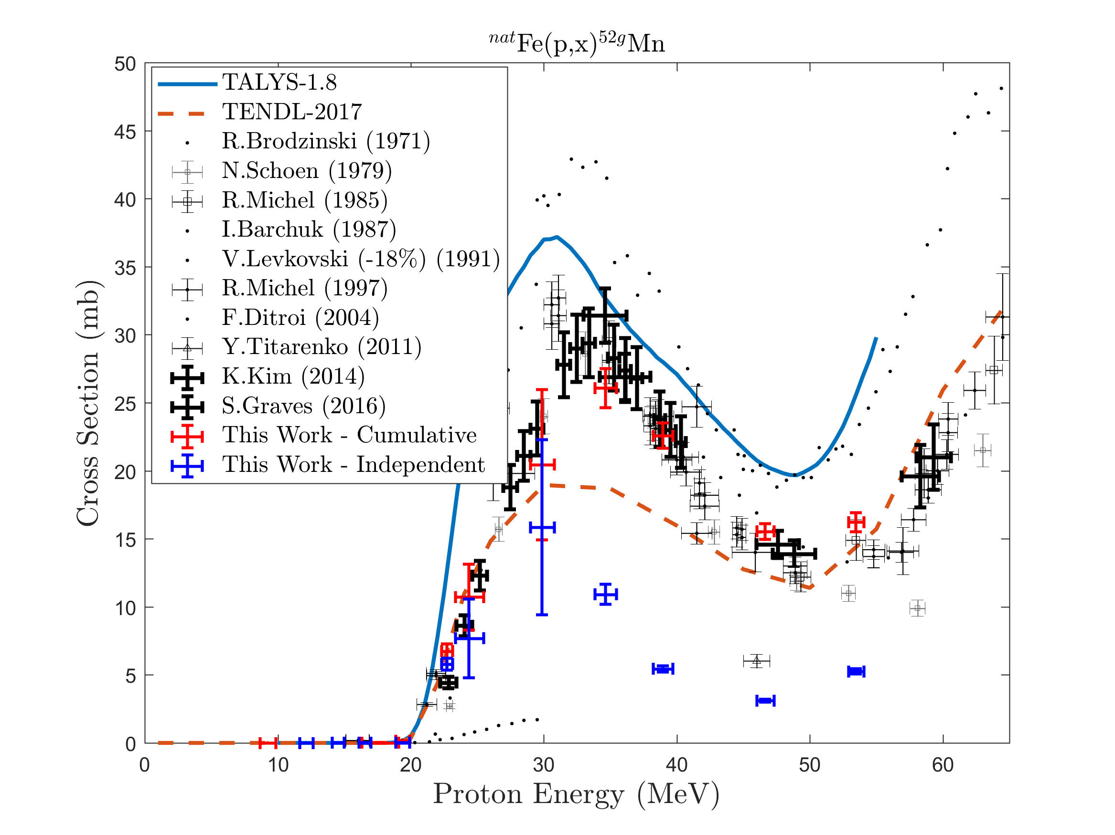
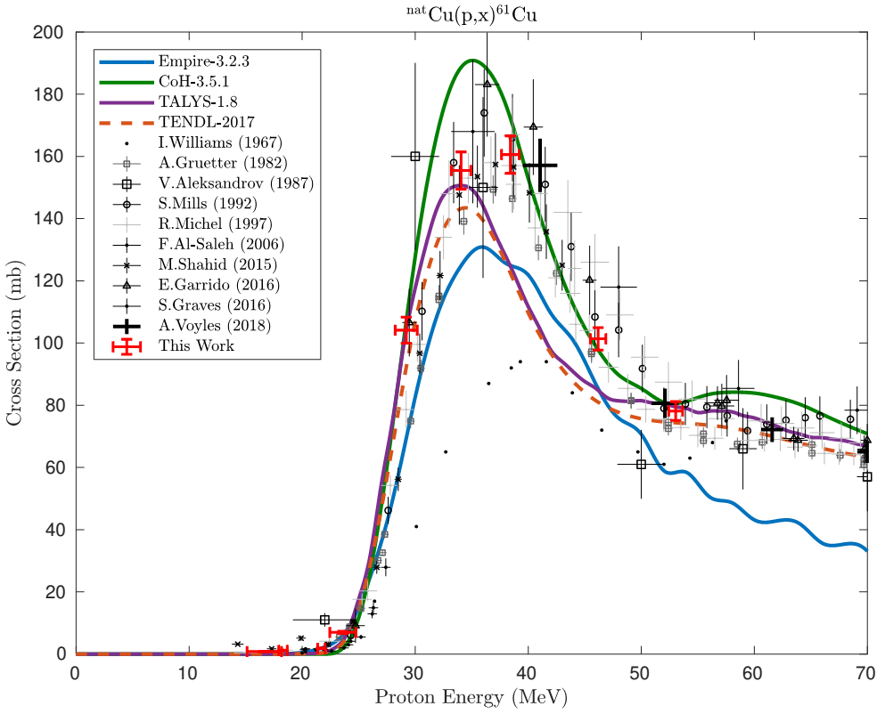
^{nat}Fe(p,x)^{51,52}Mn – Novel PET imaging
Two overlapping stacks: E_{p}= 55→15 MeV, 25→0 MeV (120 nA@10 min, 100 nA@20 min)
Notes:
Mention issues with Levkovski!
Low peak is 54Fe(p,x), high peak is 56Fe(p,x)

Slide 9
As Targetry Fabrication

Slide 10
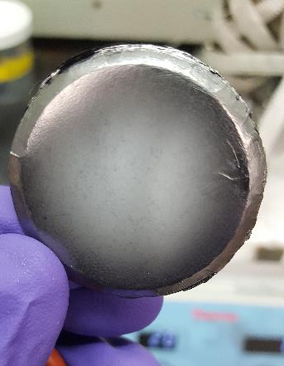
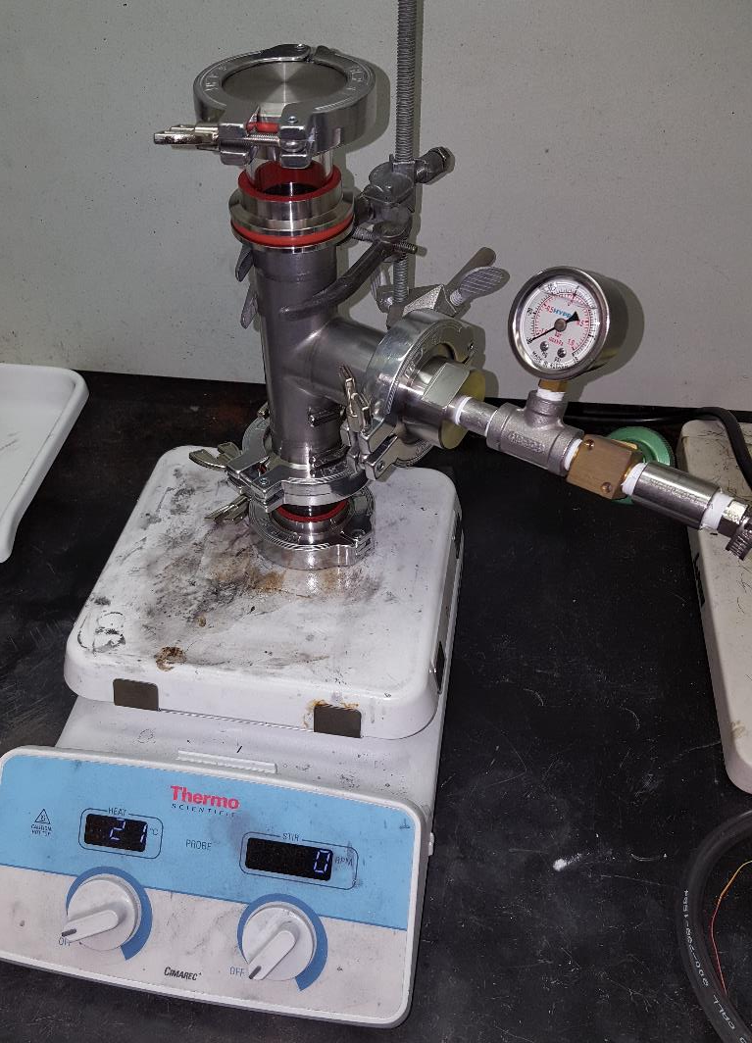
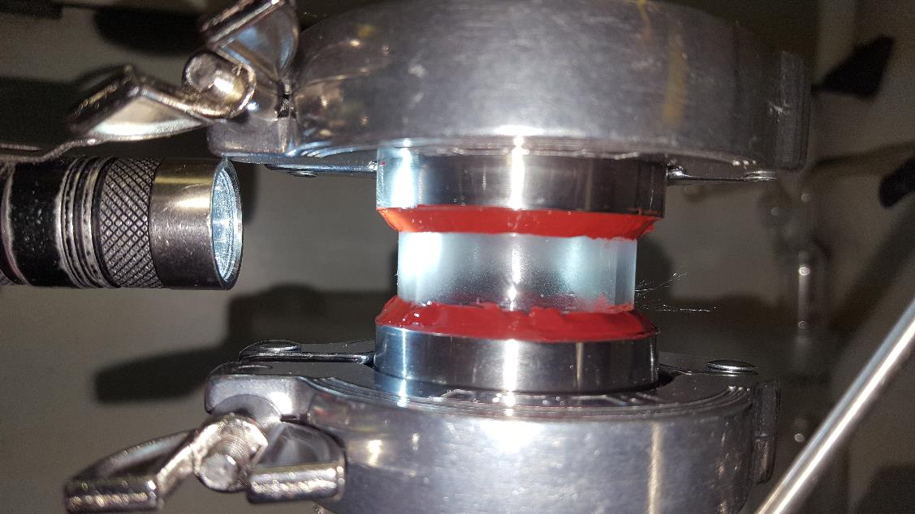
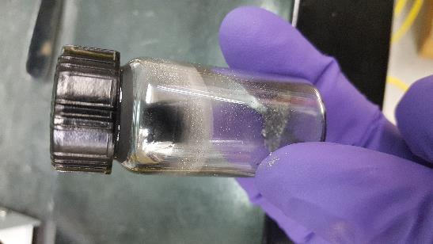
Attempt 1 = Fail Too much distance Too much As₂O₃ in old stock Adhesive breaks down above 400°C
Result was films of As₂O₃ on receiver and intermediate on sight glass. However near source was nice film of pure As

Slide 11
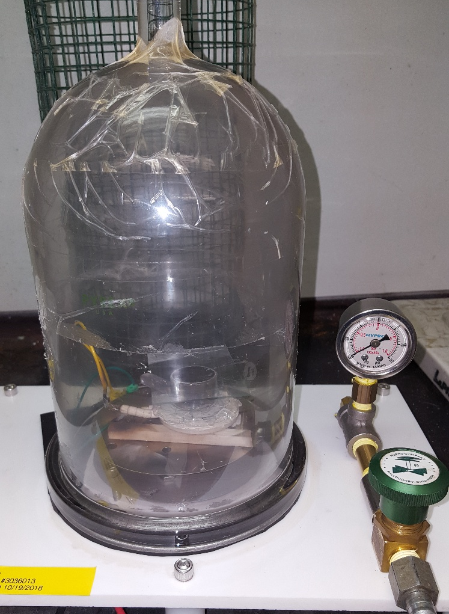
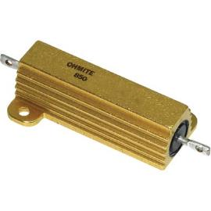
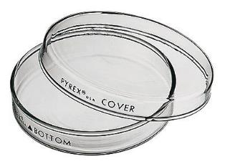

With two mini 500°C hotplates inside of vac chamber

Slide 12
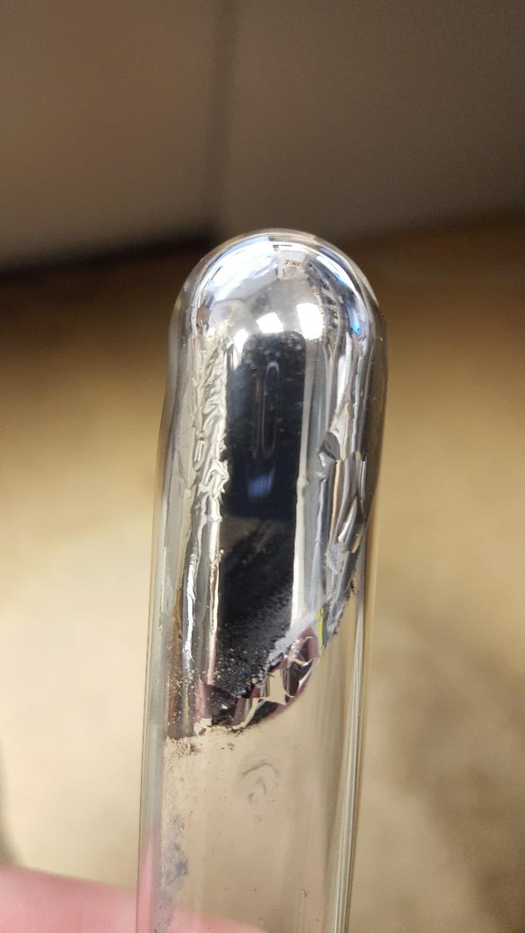
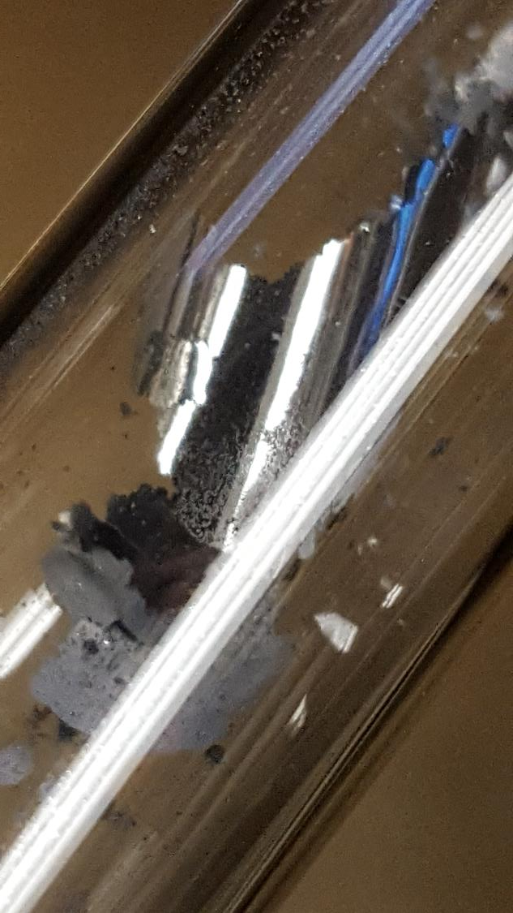
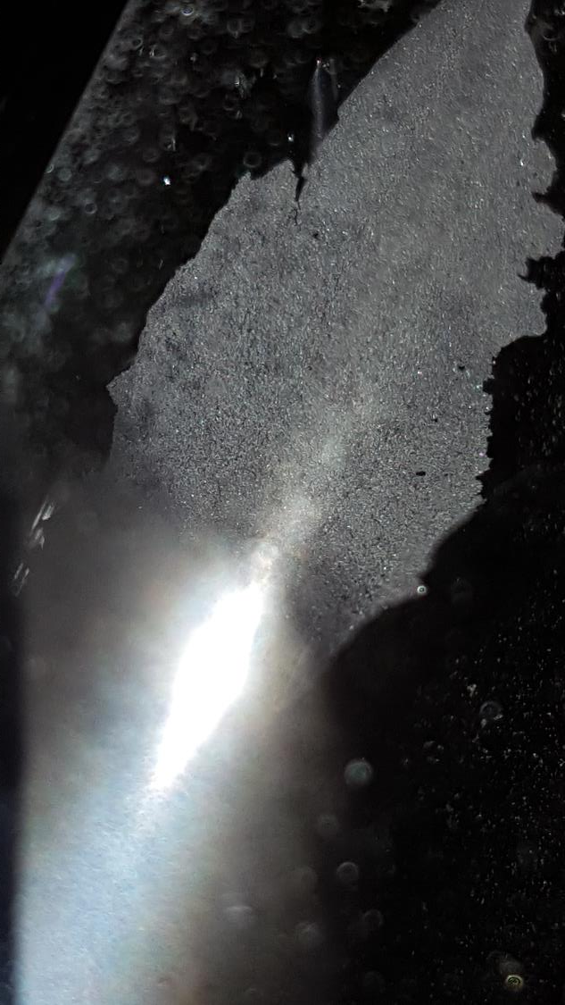

Slide 13
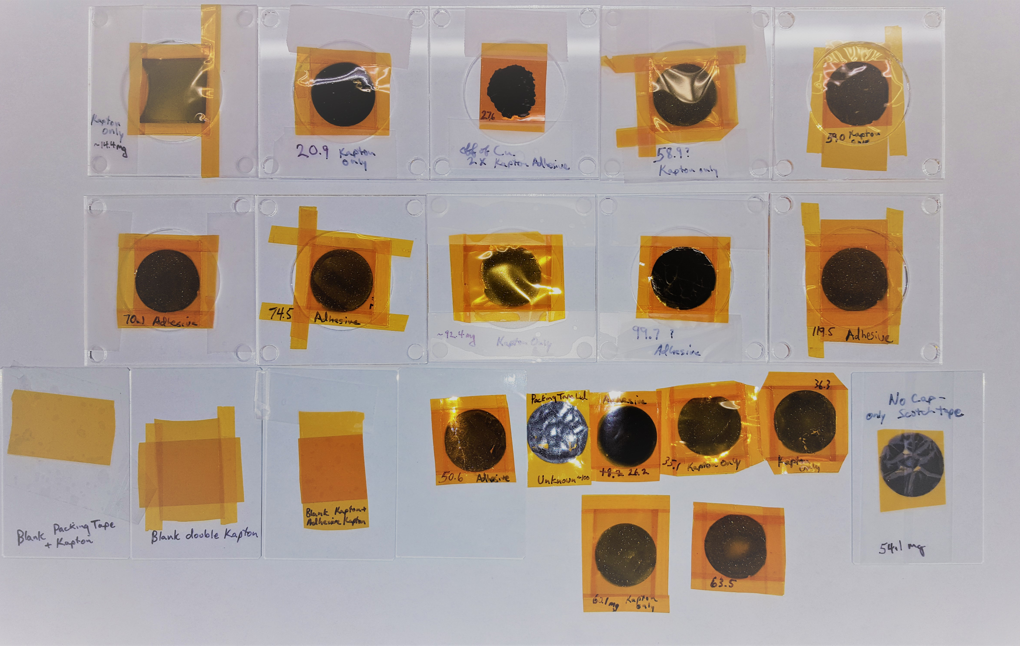
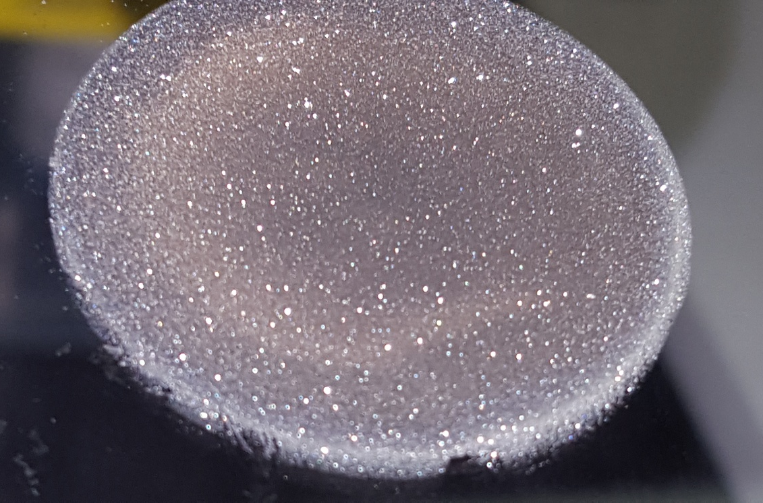
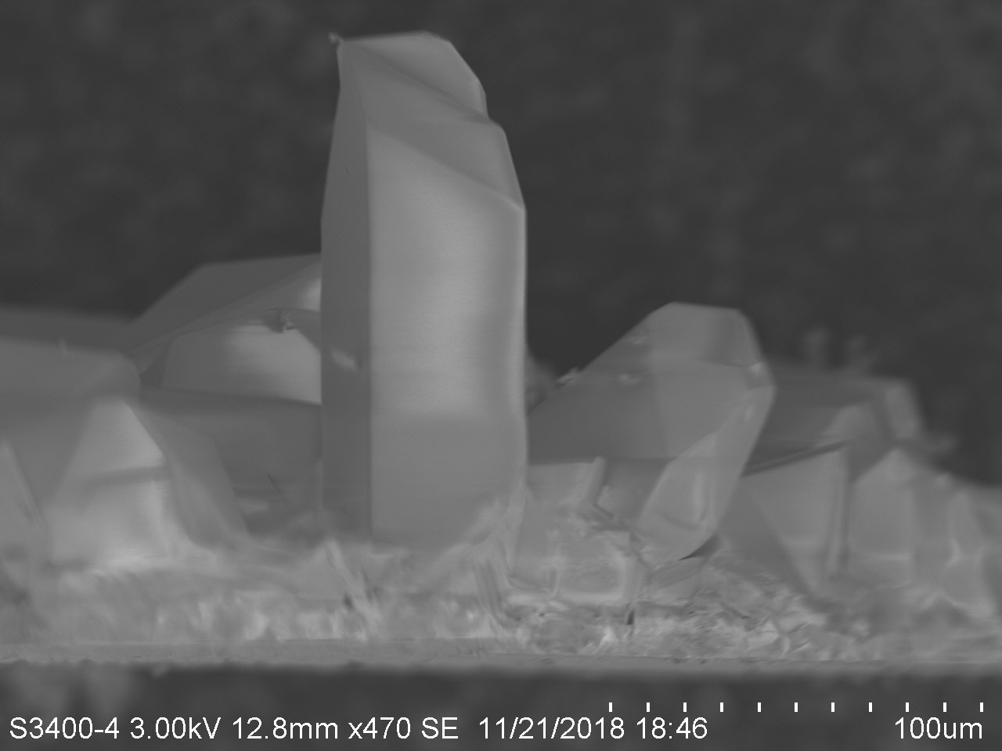
Success!!! (as of 4:54 AM…)

Slide 14
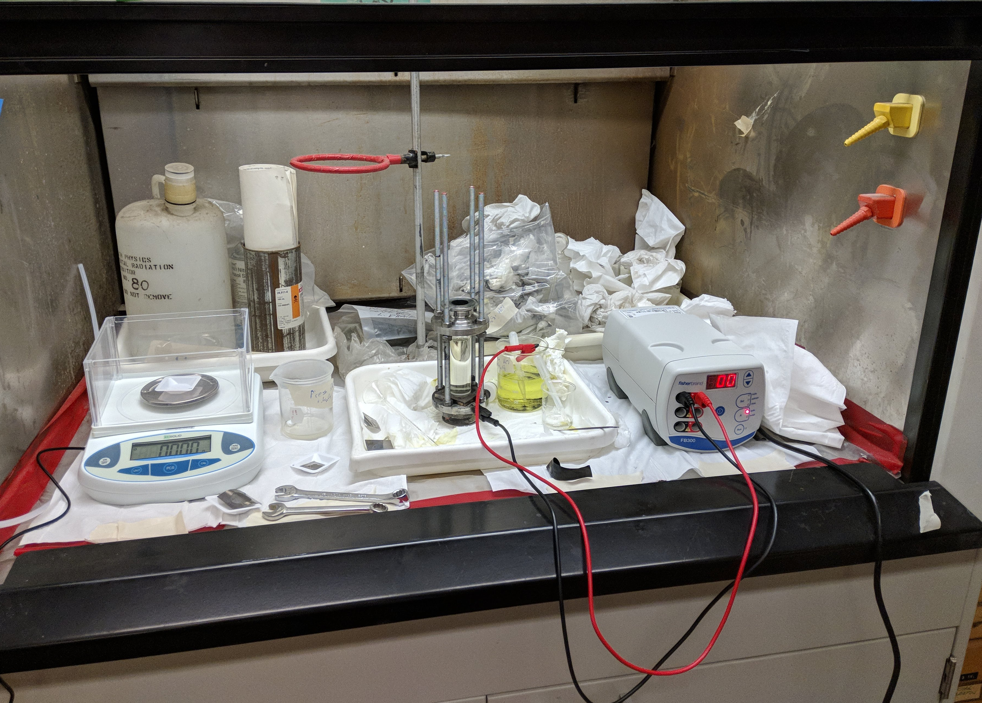
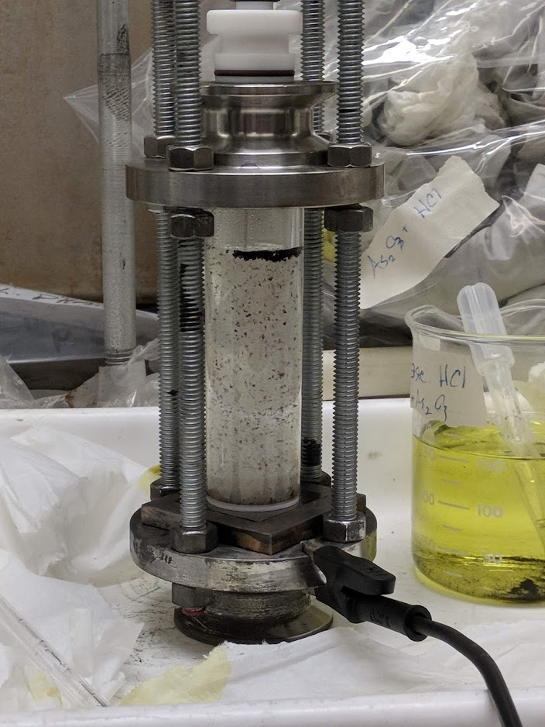
Back to Berkeley…
Two deposition methods on 10um titanium foil:
As₂O₃ (12.5 g/L) in 7M HCl, @ 130 mA
As₂O₃ (0.2M) in 1:2 molar choline chloride : ethylene glycol deep eutectic solvent, @ 46 mA
Teflon anode guide
Platinum rod anode
Plating solution, in glass tube
Teflon o-ring
Backing foil
Brass cathode
Stainless base + support

Slide 15
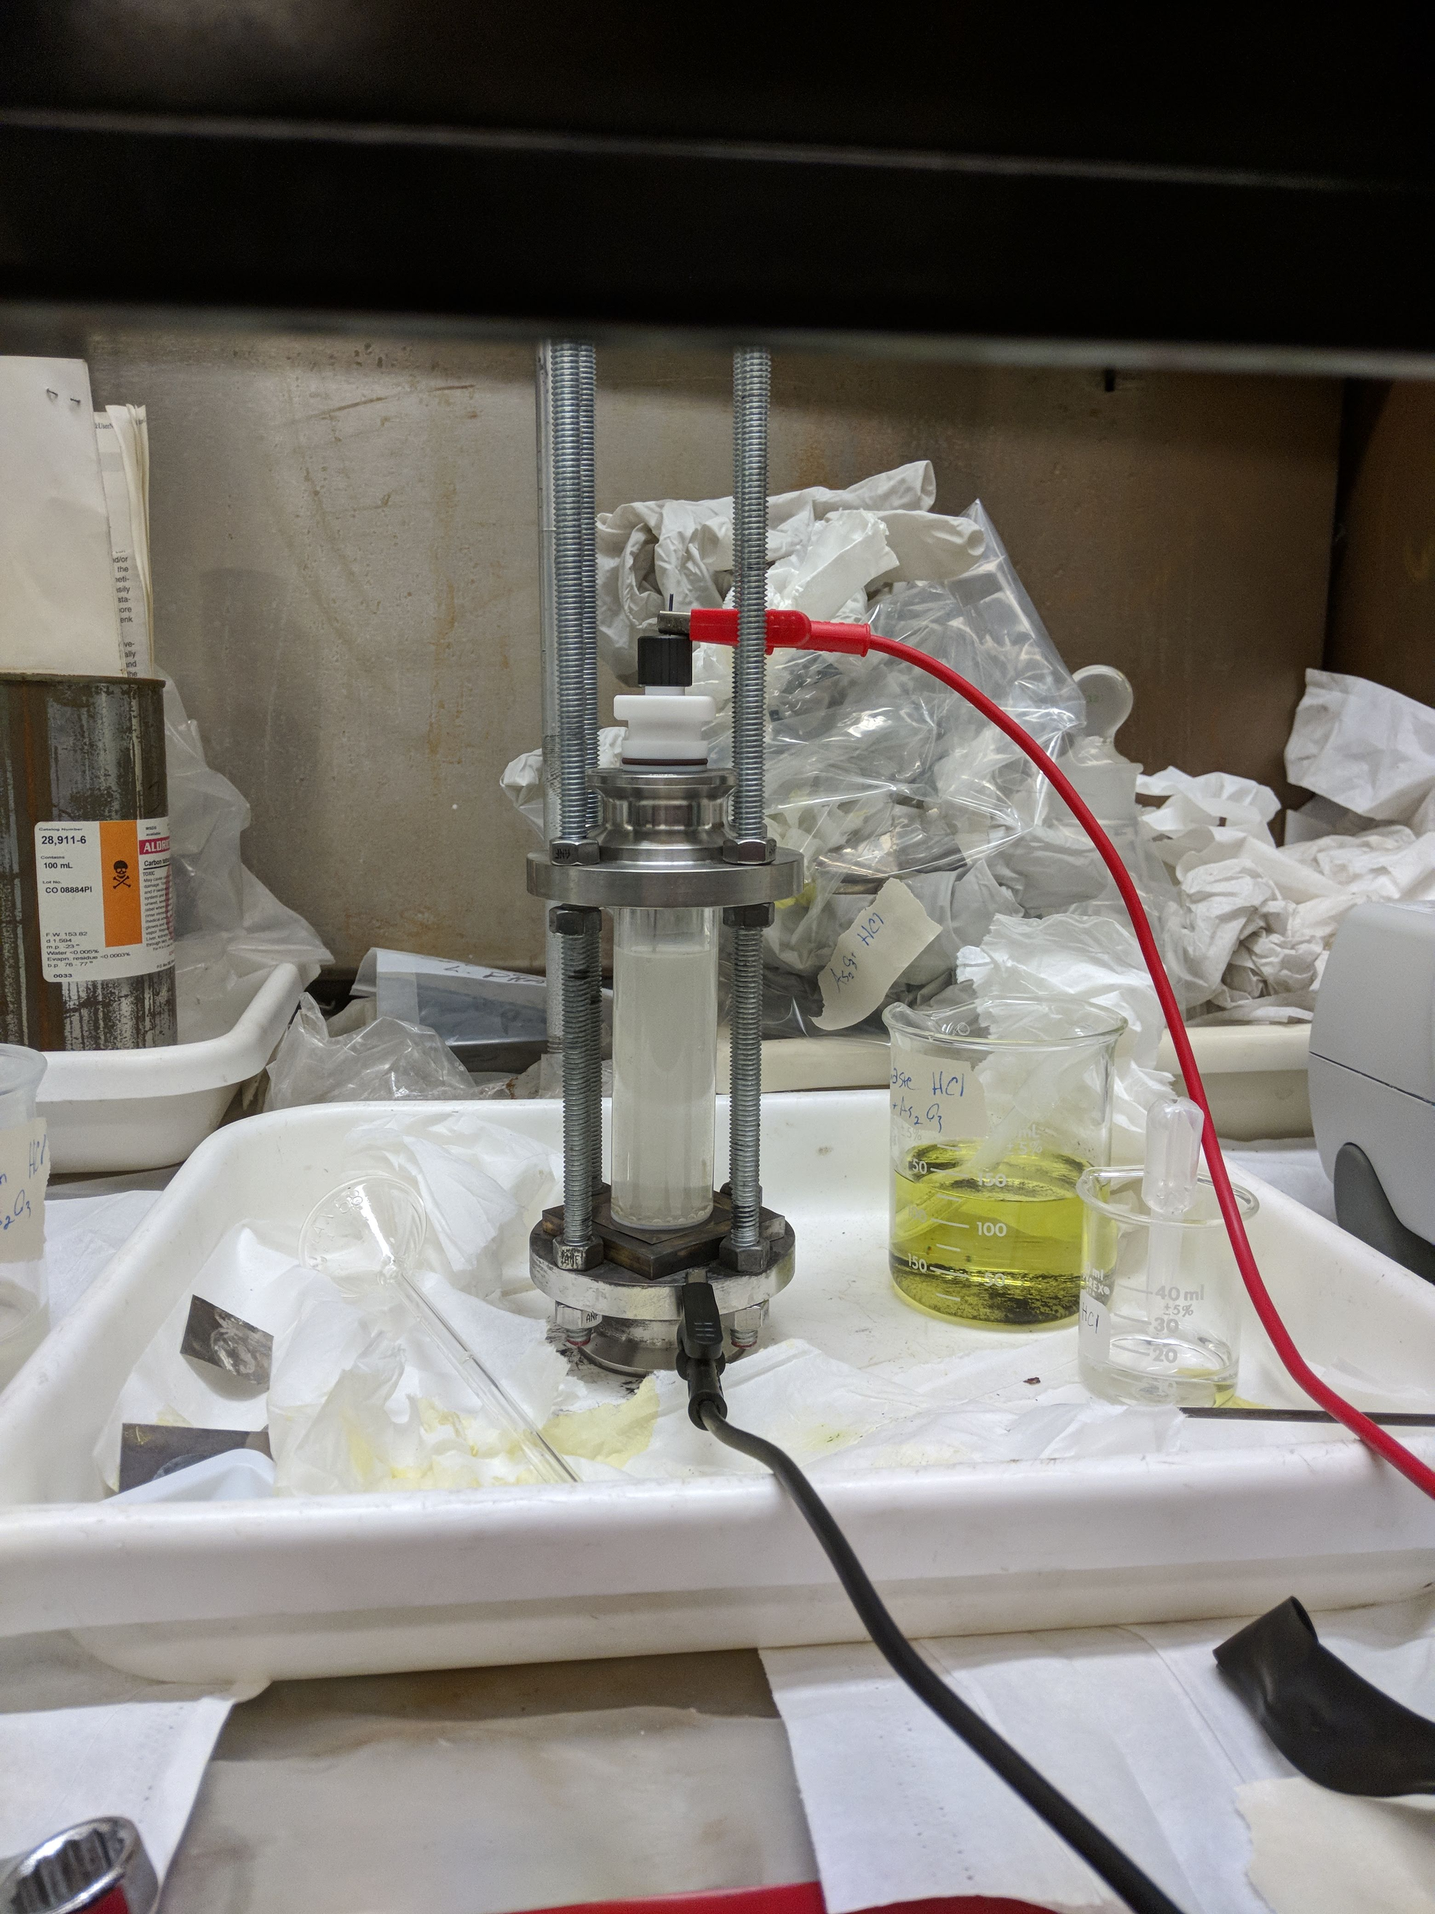
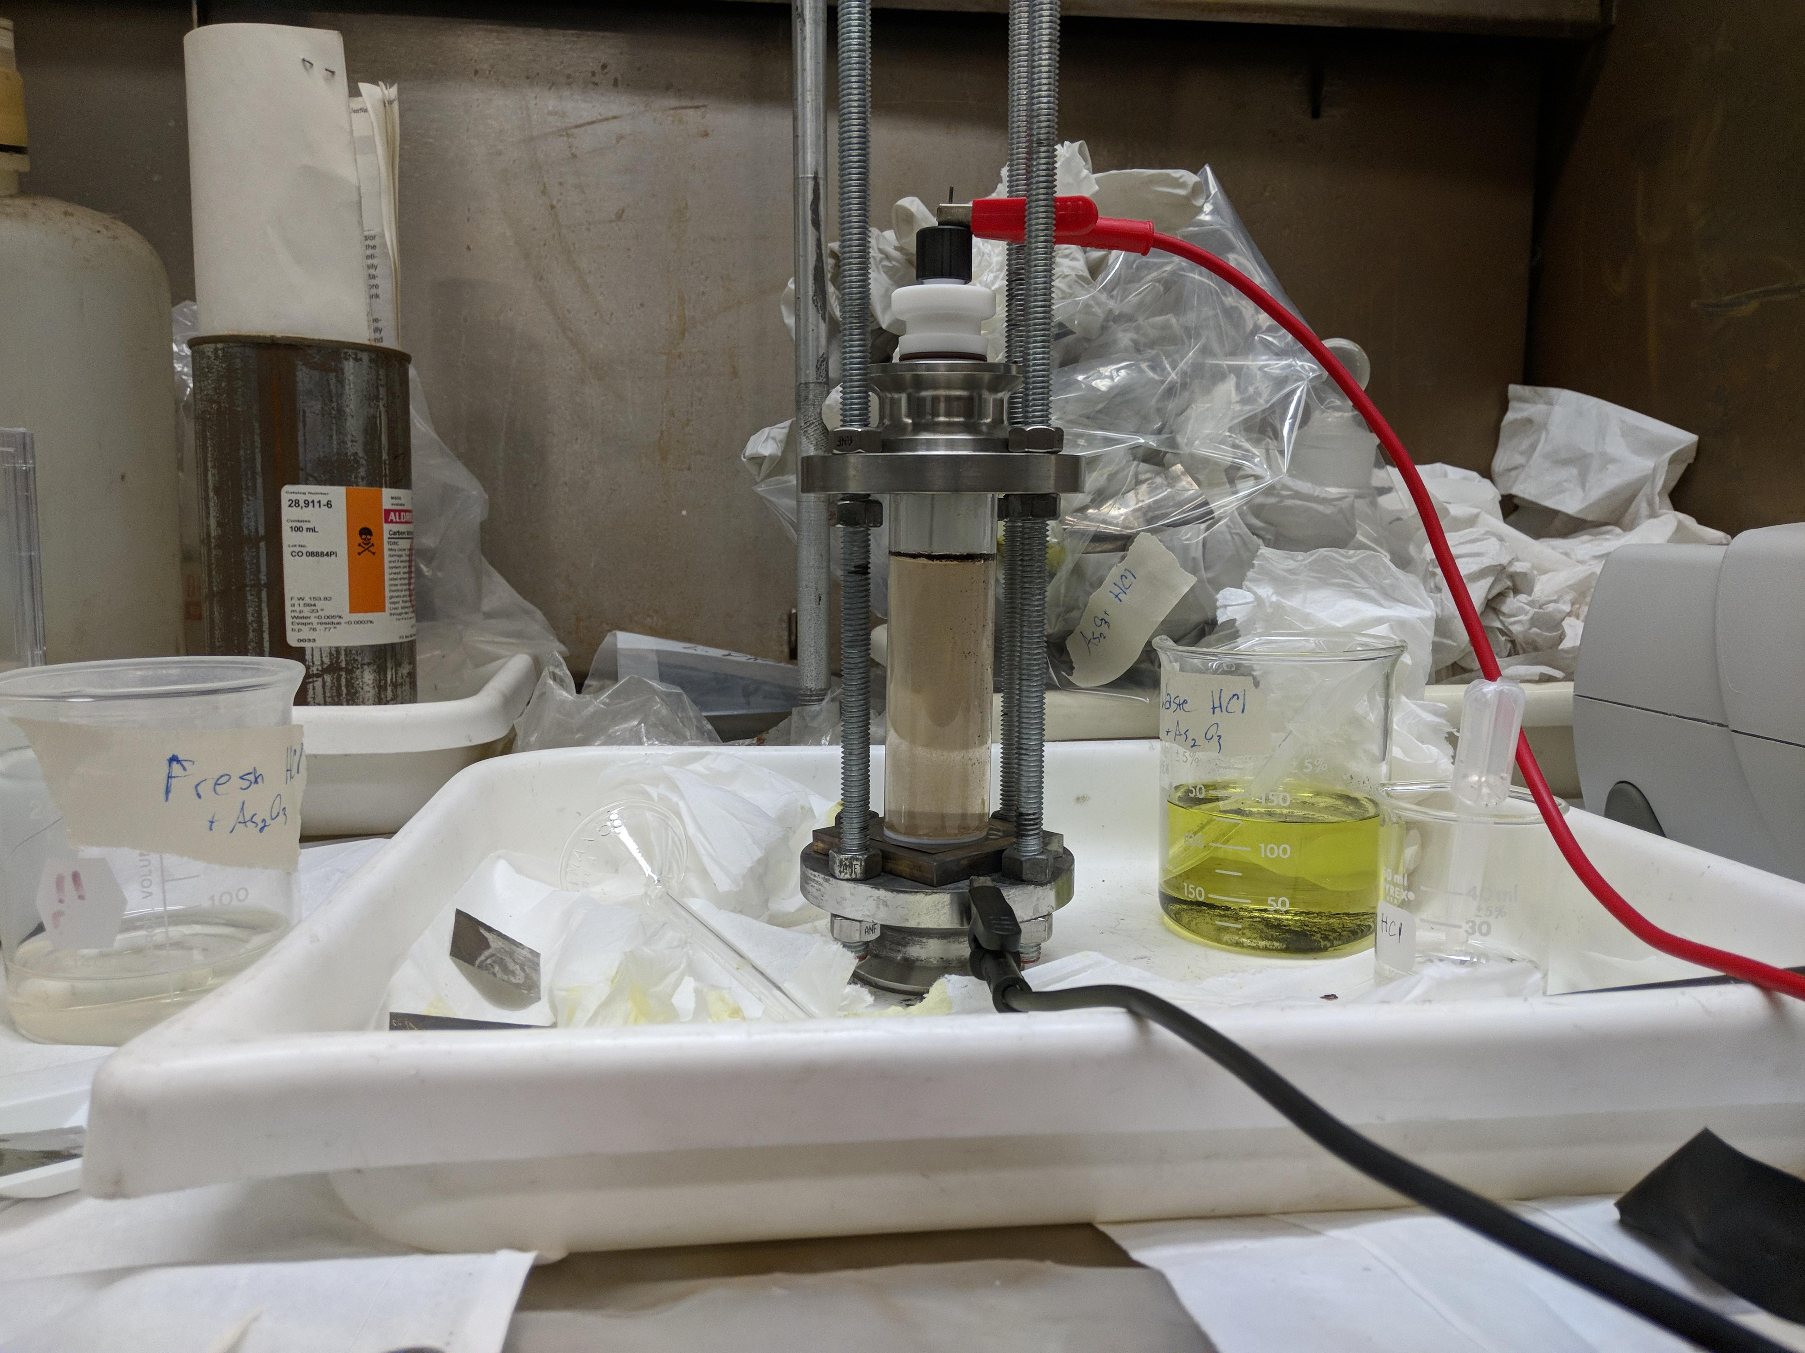
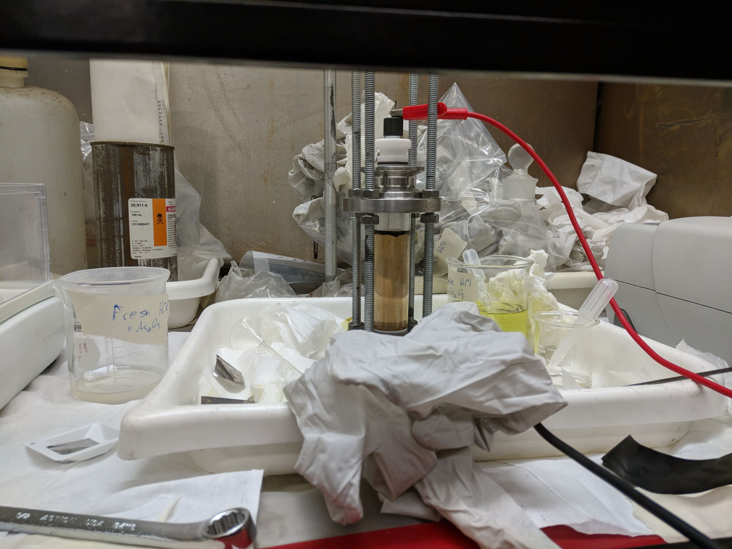
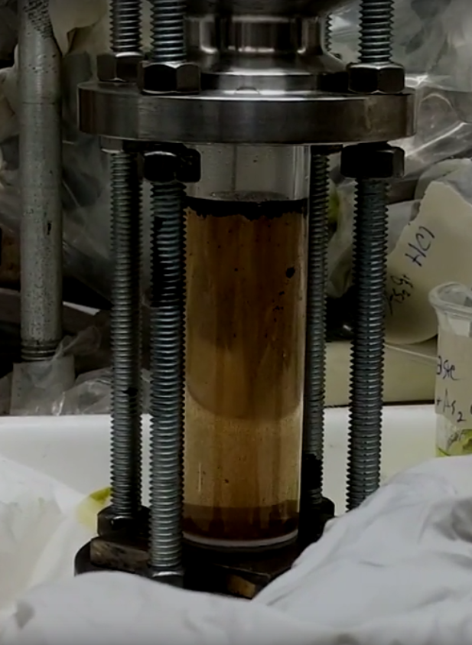

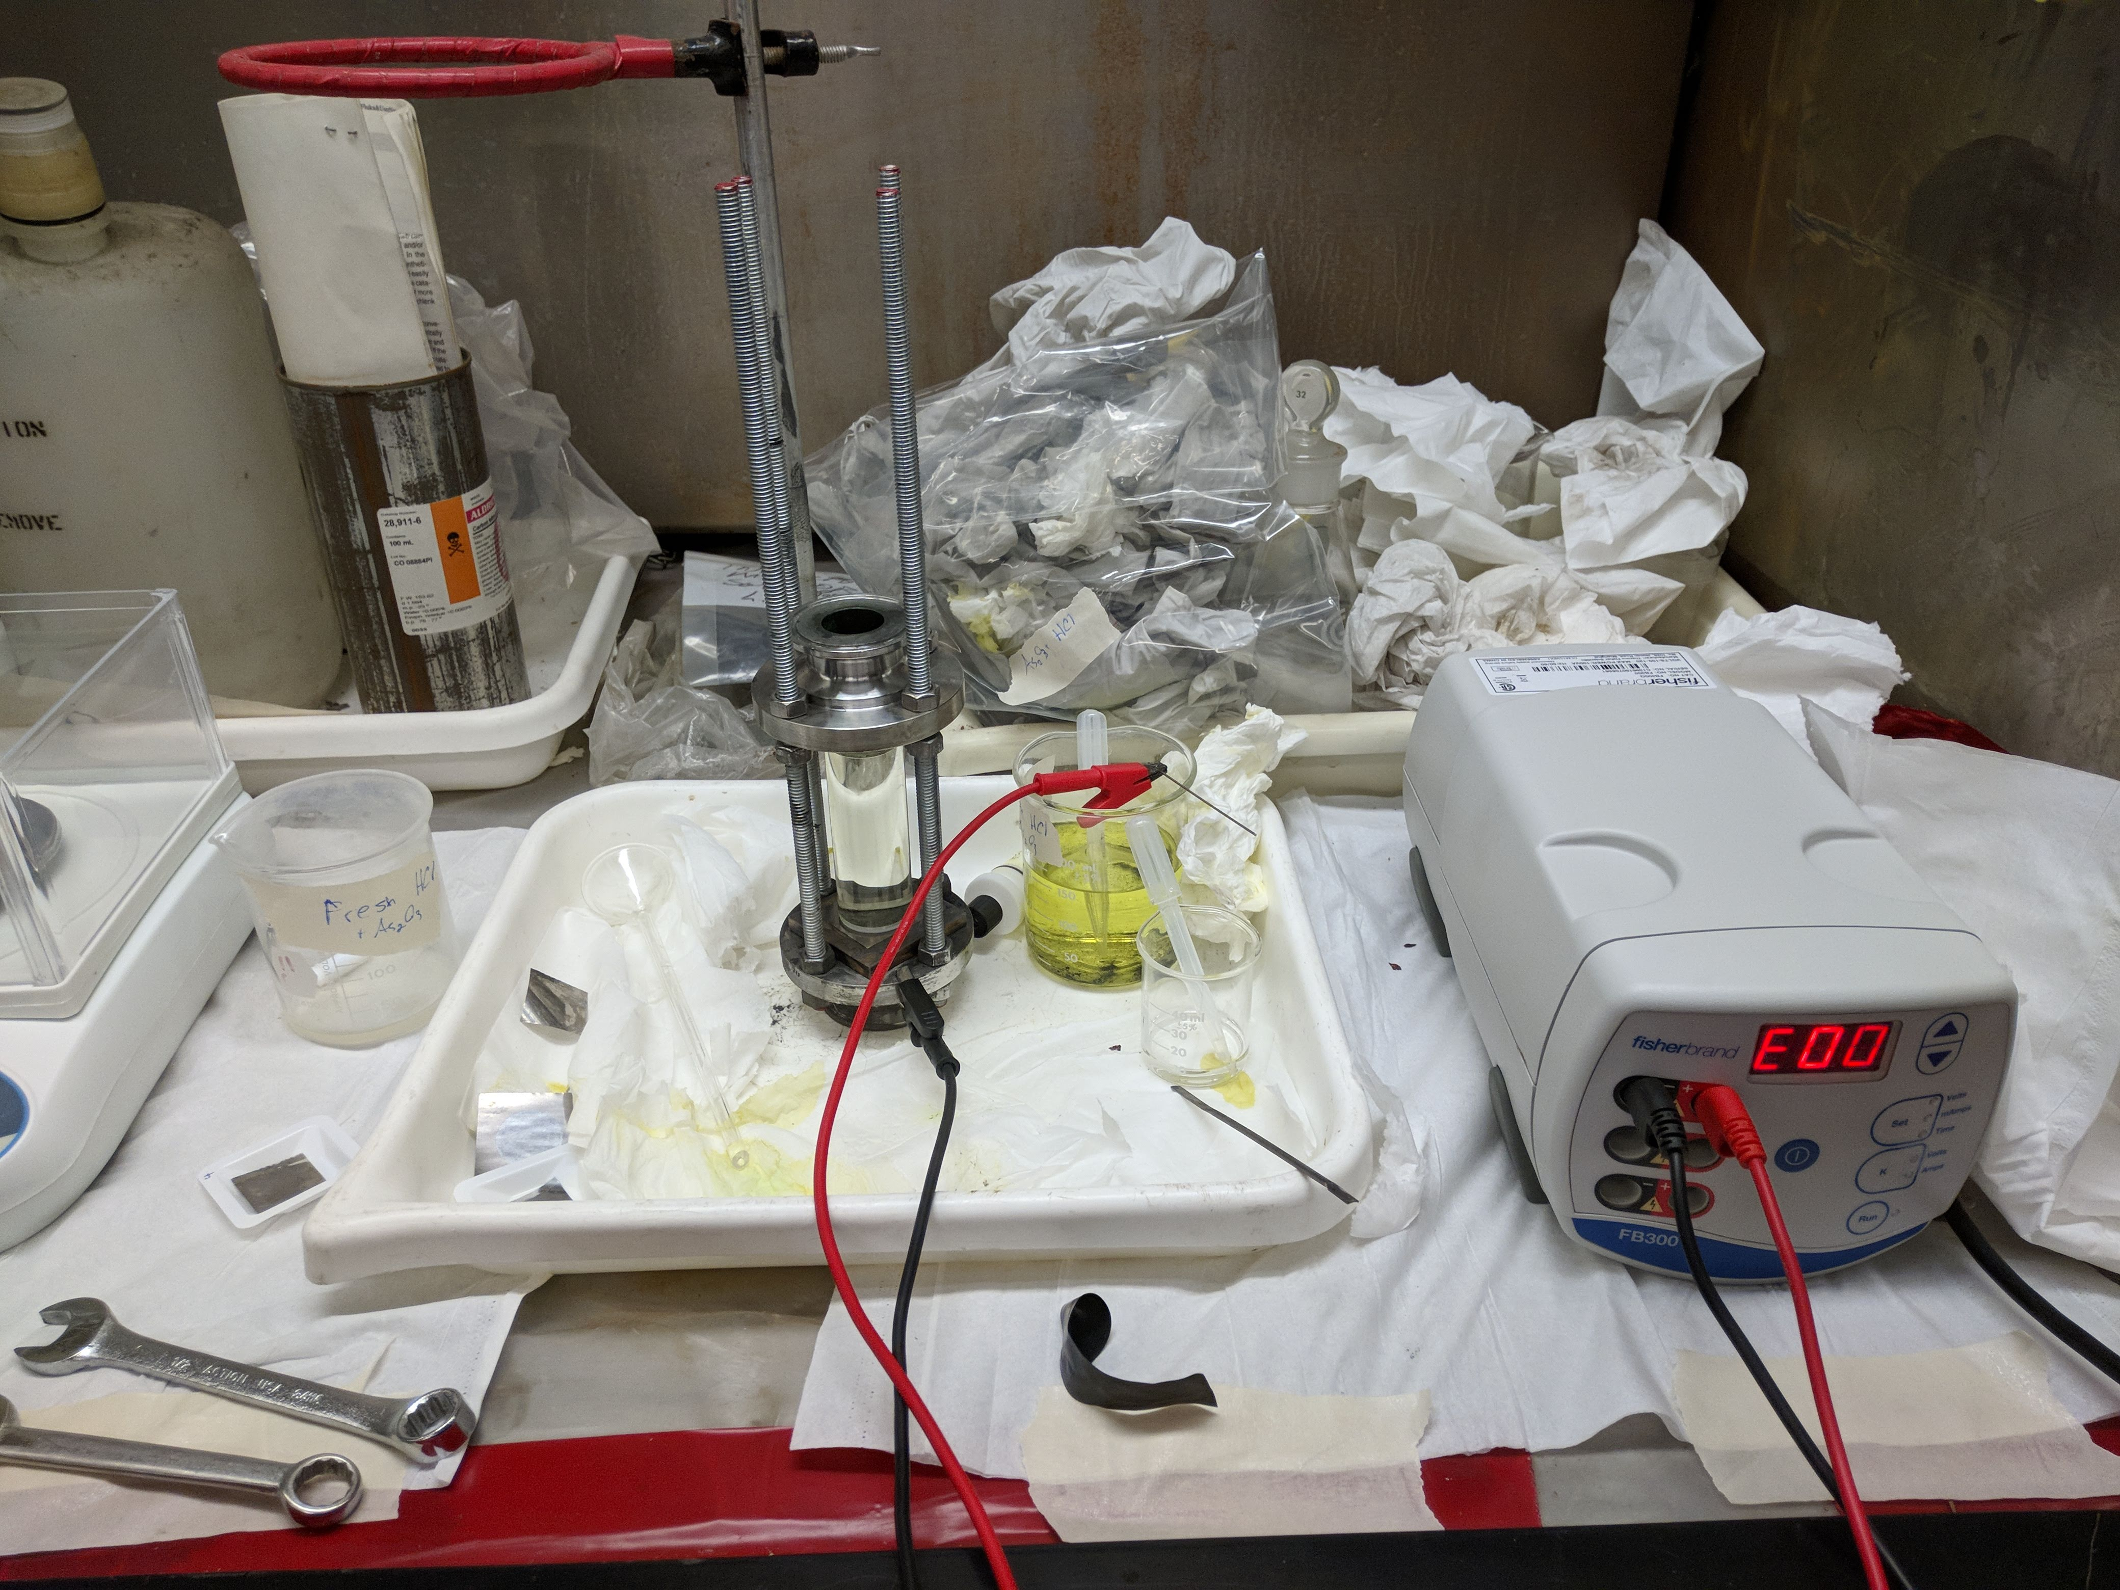
t₀
t=0.5 h
t=1 h
t=1.5 h
t=2 h
t=2.5 h

Slide 16
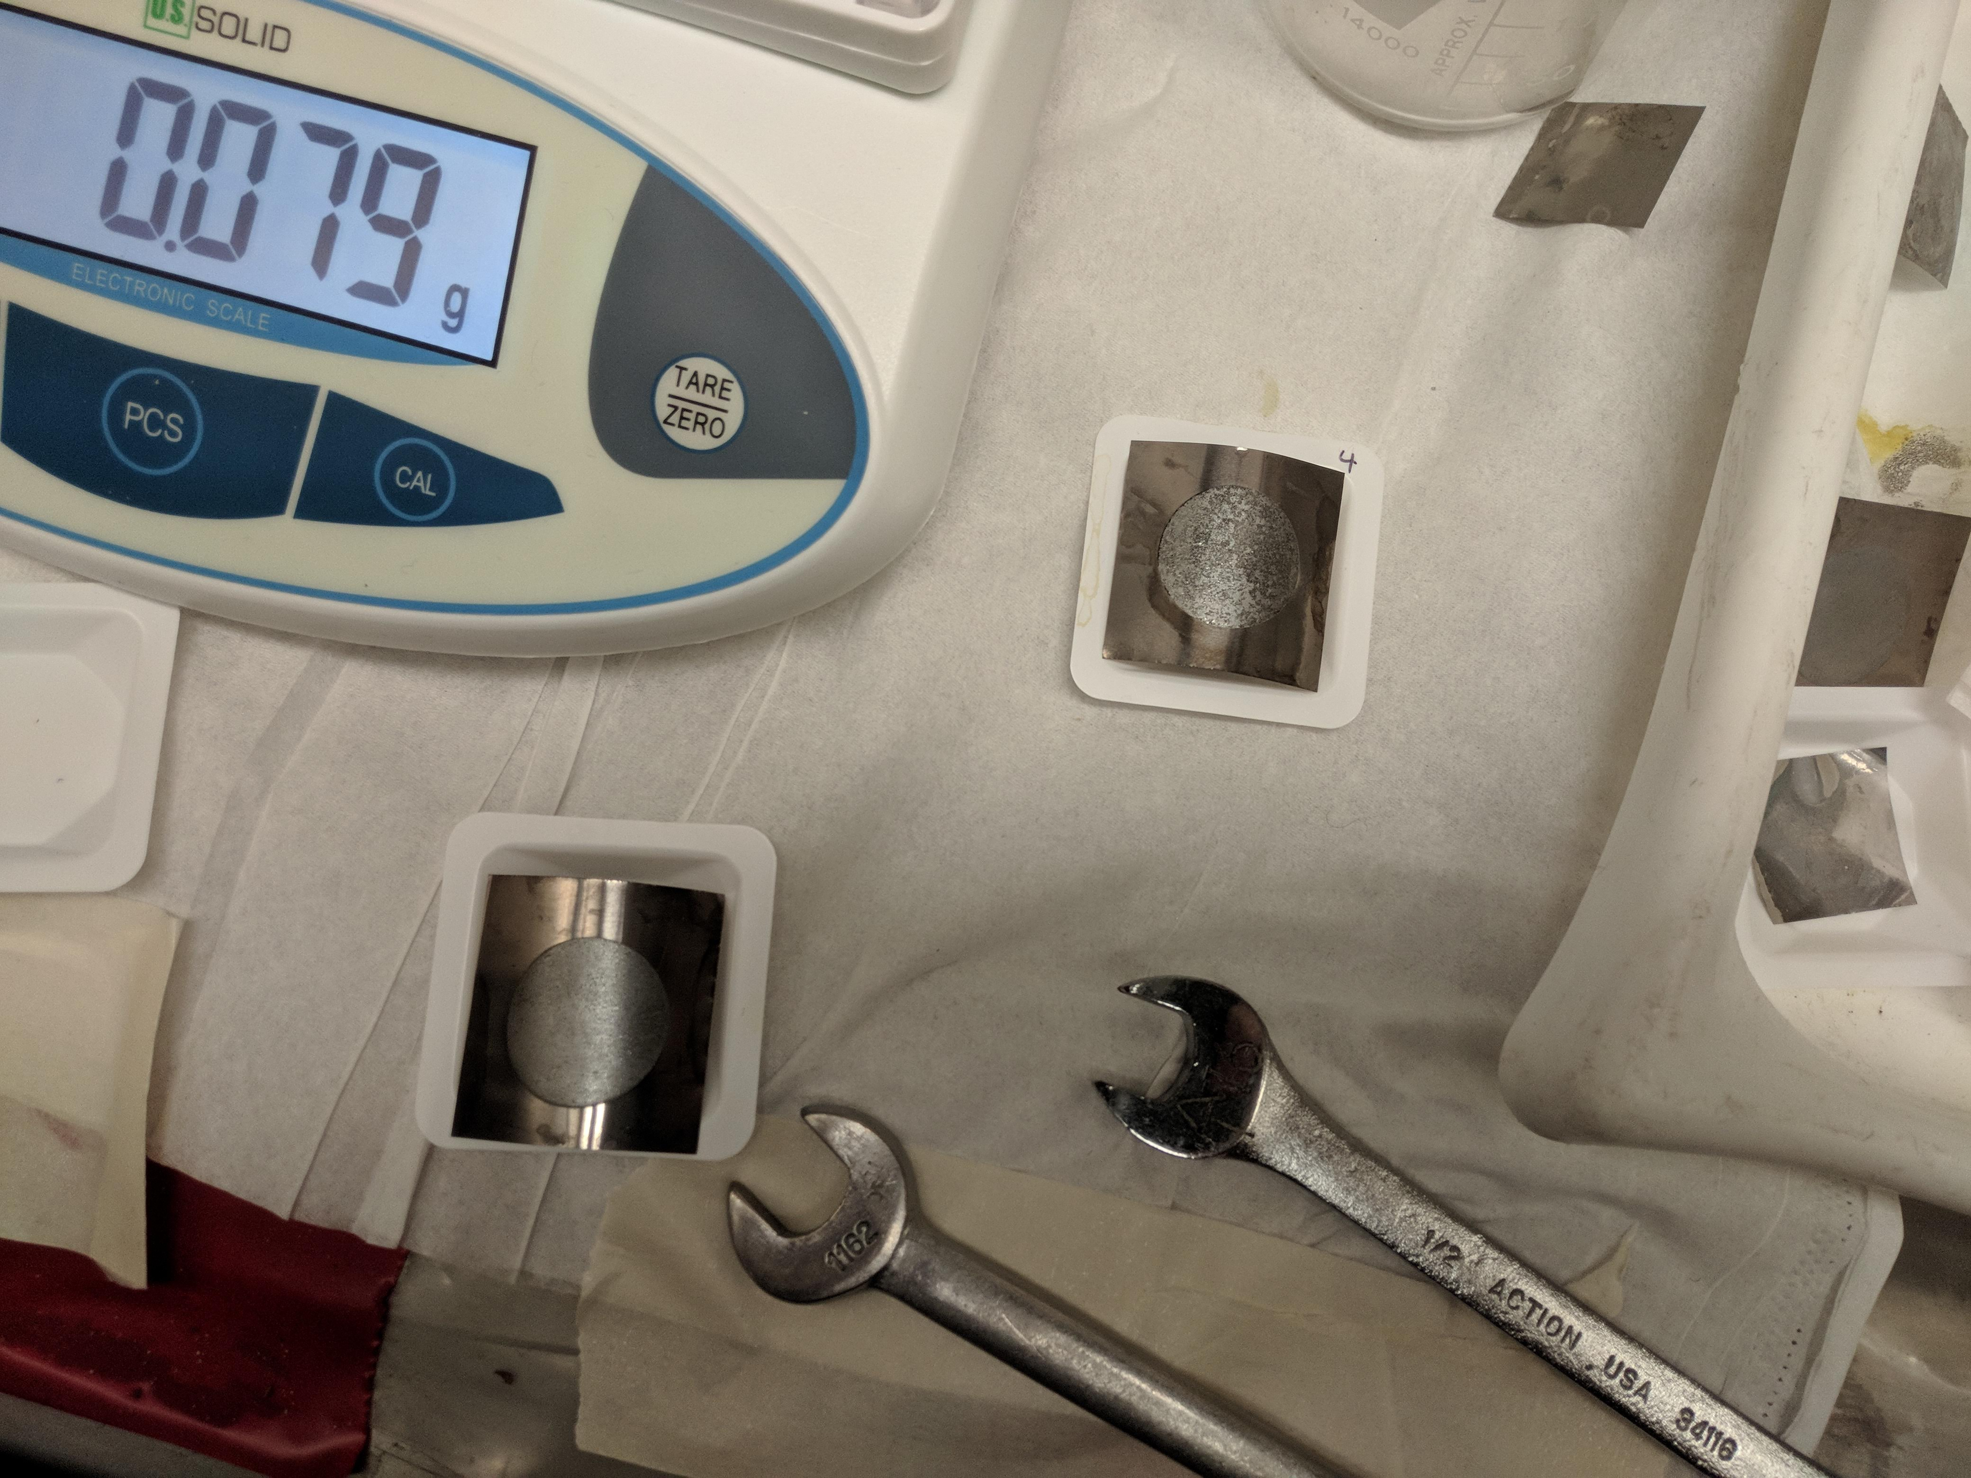
~6 mg/cm²
2.5 h @ 130 mA
~0.5 mg/cm²
15 m @ 30 mA

Slide 17

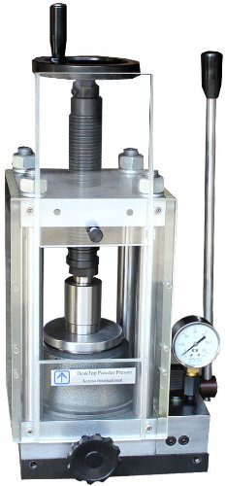
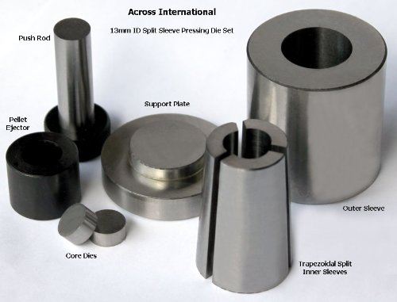
Next steps
Characterization of all As targets
Continue fabricating electroplated As targets
Pending new WPC approval
Need relevant group members to take some more training
Start development of pressed-powder As targets
As, As₂O₃, Cu₃As, FeAs, Zn₃As₂…

